Slide 1
Customer Retention Analysis Report
Jan 19, 2025
Anam Alfiya

Slide 2
Part 1
Customer Segment

Slide 3
Segmentation - Objective and Criteria
The main goal of this segmentation is to identify the most valuable customer segments who consistently engage with the brand and contribute the most value. By understanding these segments, we can tailor strategies to maximize retention, loyalty, and revenue of the company
Key Criteria for Segmentation
1.Recency:
Time elapsed since the customer’s last purchase.
This indicates how recently a customer has engaged with the brand and helps prioritize outreach.
2. Frequency:
The number of purchases made within a specific time period.
High-frequency customers often reflect loyalty and consistent interest in the brand.
3. Engagement Metrics:
Behavioral indicators such as pages visited, time spent on the site, and promotional email response rates.
These metrics provide insights into customer interest, responsiveness, and overall involvement with the brand.
Detailed criteria and assumption for segmentation for each element can be found in this attached Sheet

Slide 4
Segmentation
Segment Name | Segment Health | Customer Count | % Distribution
Cluster 1 | Top Value Customer | 342 | 17.15%
Cluster 2 | High Value Customer | 779 | 39.07%
Cluster 3 | Medium Value Customer | 663 | 33.25%
Cluster 4 | Low Value Customer | 163 | 8.17%
Cluster 5 | At-Risk Customer | 47 | 2.36%

Slide 5
Segment wise Spend
Segment Name | Segment Health | Customer Count | % Distribution | Customer Spend | % Distribution
Cluster 1 | Top Value Customer | 342 | 17.15% | 1332535 | 26.22%
Cluster 2 | High Value Customer | 779 | 39.07% | 2224425 | 43.78%
Cluster 3 | Medium Value Customer | 663 | 33.25% | 1306062 | 25.70%
Cluster 4 | Low Value Customer | 163 | 8.17% | 181919 | 3.58%
Cluster 5 | At-Risk Customer | 47 | 2.36% | 35692 | 0.70%

Slide 6
Part 2
Segment Wise Analysis
Retention and Upsell Strategy

Slide 7
Cluster 1 - High Value Customer
Segment Analysis

Slide 8
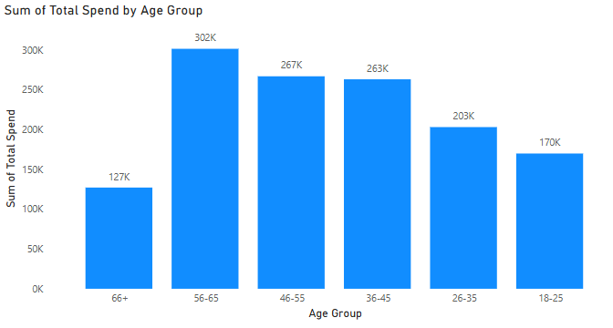
Cluster 1 - Top Value Customer
Observation and Challenges
Variability in Total Spend:
Range: $1,291 to $4,997
Standard Deviation: $834.81
Lower Quartile (25%): 86 customers (25.15% of the segment) are in the lowest quartile of spend ($1,291–$3,382).
These customers may not feel prioritized, increasing the risk of attrition.
Total Spend by Age within this group
36-65 Age group contributes the highest among the Top Value customer:
56-65 accounted for 22.64% of Sum of Total Spend.

Slide 9
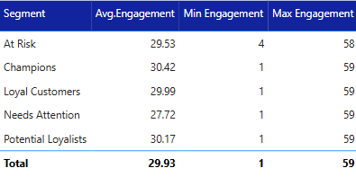
Cluster 1 - Top Value Customer
Observation and Challenges
Engagement with Brand:
Time on Site:
Range: 1 to 59 minutes
Median: 29 minutes
Standard Deviation: 17.41 — indicates some customers spend significantly less time engaging.
Customer Satisfaction:
With Issues Resolved:
Average Spend: $3,906.79
Likelihood Impact (20% higher spend): $4,688.15
Spend Difference: +20% after resolving issues.
Why: Their loyalty increases significantly with issue resolution, ensuring upsell opportunities.
Without Issues Resolved:
Average Spend: $3,874.47
Likelihood Impact (10% lower spend): $3,487.02
Spend Difference: -10% when issues remain unresolved.
Why: Even small unresolved issues negatively impact their high loyalty.

Slide 10
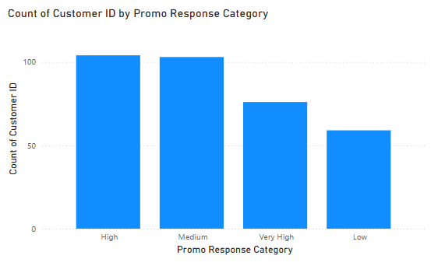
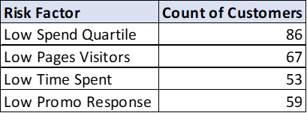
Cluster 1 - Top Value Customer
Promo Response:
"High" (104) and "Medium" (103) dominate, with room to improve for "Low" (59 customers).
59 customers (17.3% of the "Champions" segment) fall into the "Low" promo response category, representing a challenge in converting this subgroup.
Less responsiveness to promotions increases the likelihood of churn.
Despite high average engagement and spend, variability in metrics indicates potential for attrition if these customers are not continuously engaged with meaningful offers and experiences.

Slide 11
Recommendation for Retention and Upsell
1. Variability in total spend (25 % of Segment, 86 Customers):
Challenge: These customers spend significantly less than their peers, indicating potential disengagement or lower perceived value.
Recommendation:
Tiered Incentives: We can Introduce spend-based rewards or discounts after exceeding a threshold spend. For example, offer a 10% discount for spending $500 more than their current average.
Upselling Bundles: Recommend product bundles based on their purchase history, highlighting savings (e.g., "Buy X, get 20% off Y").
Quantifiable Impact:
If 50% of these customers increase their spend by $500 each, it could add $21,500 in revenue.

Slide 12
Recommendation for Retention and Upsell
2. Engage Low Pages Visitors (19.59%, 67 Customers):
Challenge: Limited browsing suggests reduced interest or difficulty finding products.
Recommendation:
Personalized Recommendations: Send targeted email campaigns featuring products related to their previous purchases or browsing history.
Site Navigation Improvement: Introduce AI-driven "You Might Also Like" suggestions on the homepage or product pages.
Quantifiable Impact:
Increasing page views for this group by 50% could lead to an estimated 20% increase in conversions, based on industry benchmarks.

Slide 13
Recommendation for Retention and Upsell
3. Convert Low Promo Responders (17.25%, 59 Customers):
Challenge: Low responsiveness to promotions suggests the current strategy isn't resonating with them.
Recommendation:
High-Value Offers: Create exclusive, high-value promotions (e.g., early access to new products or "buy one, get one free" offers).
Feedback Surveys: Ask these customers for feedback on promotions and incorporate their suggestions.
Quantifiable Impact:
If 30% of these customers respond to personalized promotions, this could generate an additional $20,000 in revenue.

Slide 14
Cluster 2 - High Value Customer
Segment Analysis

Slide 15
Observation and Challenges
Low Spend Quartile:
Count: 195 customers (25.03% of the segment) spend less than $1,880 (lower quartile of spend).
Average total spend: $2,855.49
Challenge: A significant portion of "Loyal Customers" contributes minimally to revenue.
Low Pages Visitors:
Count: 174 customers (22.34% of the segment) visited 10 or fewer pages.
Challenge: Limited browsing indicates reduced engagement or interest in discovering new products.

Slide 16
Observation and Challenges
3. Low Time Spent:
Count: 135 customers (17.34% of the segment) spent 10 minutes or less on the site.
Average pages visited: 23.99 pages
Average time on site: 29.99 minutes
Challenge: Short session durations suggest disengagement or difficulty navigating the website.
4. Low Promo Response:
Count: 139 customers (17.84% of the segment) have "Low" responsiveness to promotions.
Challenge: Ineffective promotions result in missed opportunities for increasing purchases.
Customers with low promo responses and low purchase frequency may churn if not actively

Slide 17
Observation and Challenges
Purchase Frequency:
Medium frequency: 356 customers, Low frequency: 261 customers, High frequency: 162 customers
A majority have medium purchase frequency, indicating they may be retained with appropriate strategies.
5. Customer Engagement
With Issues Resolved:
Average Spend: $2,795.07
Likelihood Impact (20% higher spend): $3,354.08
Spend Difference: +20% after resolving issues.
Why: Effective resolution sustains loyalty and encourages higher spending
Without Issues Resolved:
Average Spend: $2,515.56
Likelihood Impact (10% lower spend): $2,264.00
Spend Difference: -10% when issues remain unresolved.
Why: Unresolved concerns lead to dissatisfaction and spending decline.

Slide 18
Recommendation for Retention and Upsell
Incentivize Low Spenders:
Situation:195 customers (25.03% of the segment) spend less than $1,880 (lower quartile of spend).
Action: Introduce tiered rewards, such as loyalty points, discounts, or gifts, for exceeding spend thresholds.

Slide 19
Recommendation for Retention and Upsell
2. Increase Engagement:
Situation: 174 customers (22.34% of the segment) visited 10 or fewer pages
Action: Use personalized content such as product recommendations to encourage more page views and time on site.
Impact: Increasing engagement for 174 low page visitors by 10% could boost conversions by ~15%, leading to additional revenue.

Slide 20
Recommendation for Retention and Upsell
Boost Promo Response:
Situation: 139 customers (17.84% of the segment) have "Low" responsiveness to promotions.
Action: Target low promo responders with exclusive, tailored offers such as early access to sales or "buy one, get one" deals.
Impact: Improving promo responsiveness for 139 low responders by 20% would generate an additional $2,000 in revenue.

Slide 21
Cluster 3 - Medium Value Customer
Segment Analysis

Slide 22
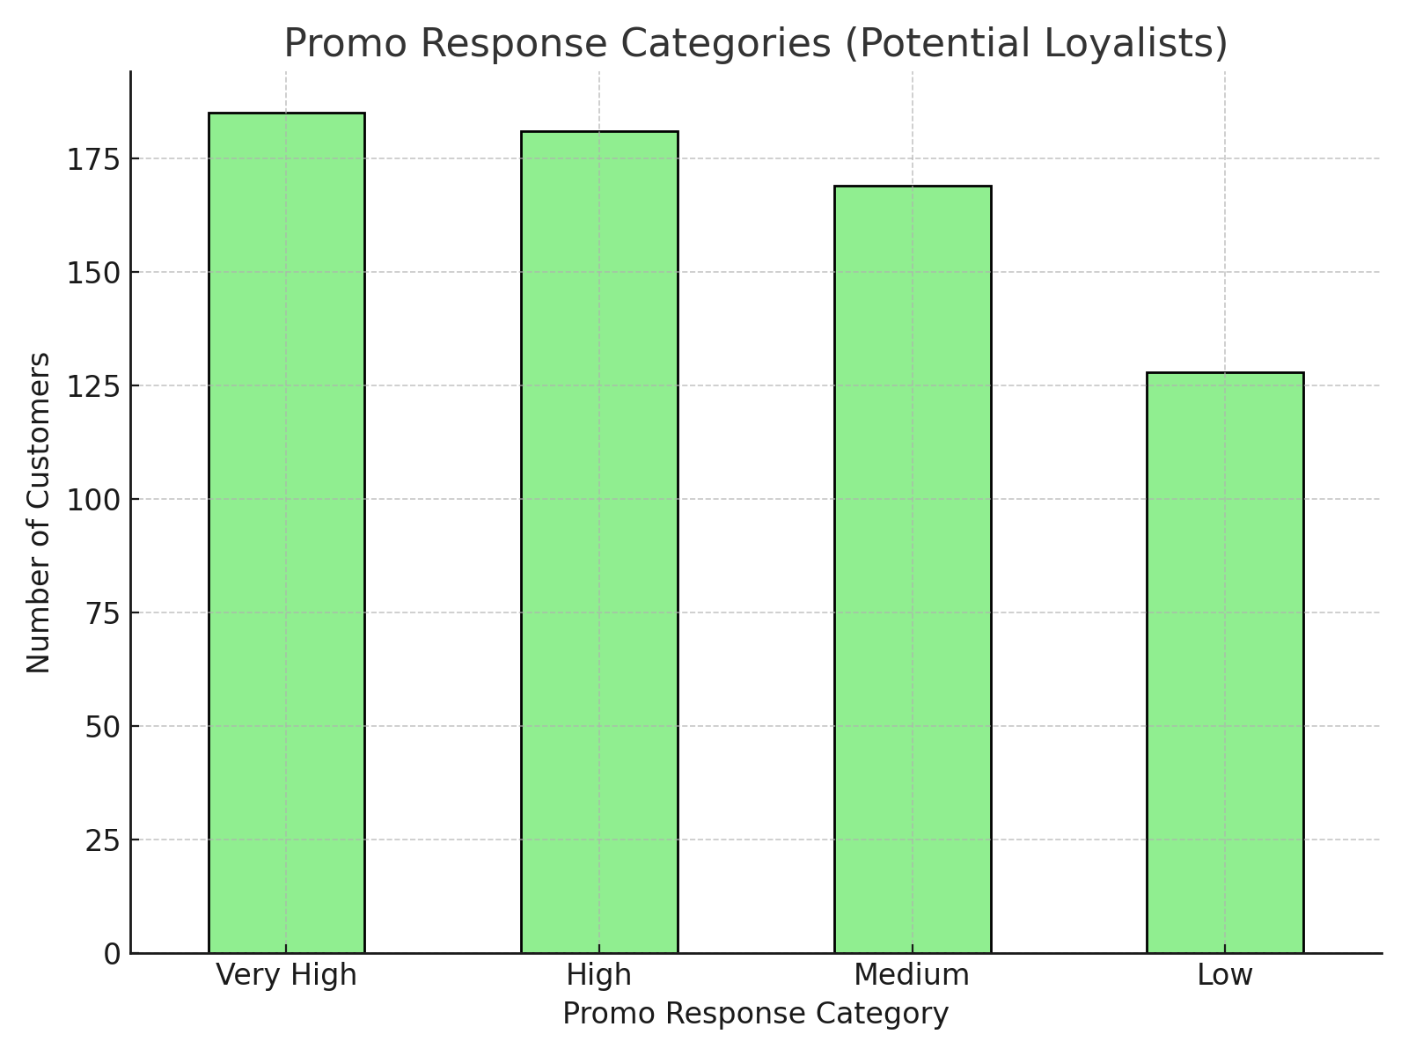
Observation and Challenges
Behavior Analysis:
Total Spend: Average $1,969.93, with wide variability ($101 to $4,999).
Engagement Metrics:
Average pages visited: 25.49 pages
Average time on site: 30.17 minutes
High variability in spend and engagement reflects diverse activity levels.
Promotion Response:
"Very High" (185) and "High" (181) promo responders dominate, but a significant proportion (128 customers) fall into the "Low" response category. This group may require different targeting strategies to convert.

Slide 23
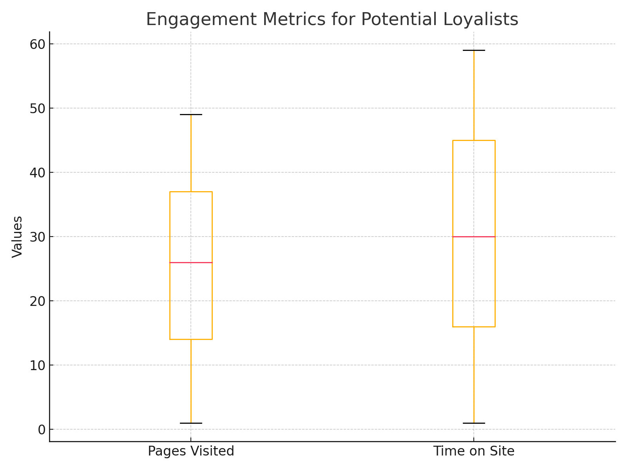
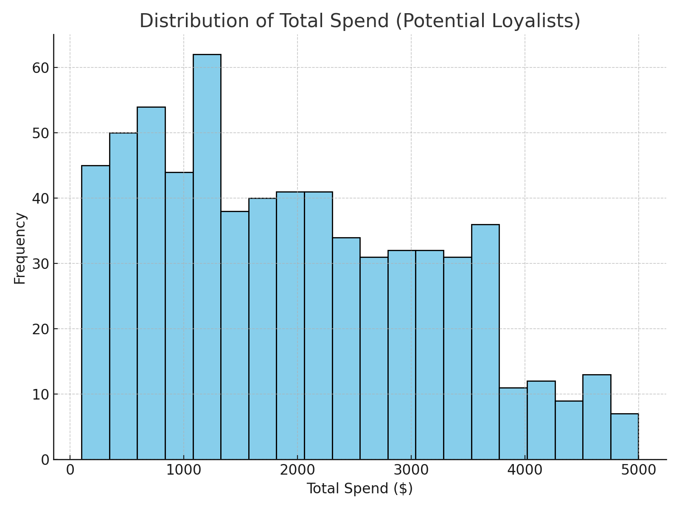
Observation and Challenges
Retention Uncertainty and Loyalty:
These customers show potential to become loyal, but their current behaviors are less predictable compared to more established loyal customers, making retention efforts less straightforward.
These customers may not fully understand the benefits of progressing to higher tiers (e.g., "Loyal Customers" or "Champions"), limiting their motivation to increase engagement.

Slide 24
Observation and Challenges
Purchase Frequency:
Medium frequency: 356 customers, Low frequency: 261 customers, High frequency: 162 customers
A majority have medium purchase frequency, indicating they may be retained with appropriate strategies.

Slide 25
Recommendation for Retention and Upsell
1. Incentivize Low Spenders
Insight:
Low Spend Quartile: 166 customers (25.04%) spend less than $947.50 (lower quartile).
Action Plan:
Launch personalized campaigns offering tiered rewards:
Highlight potential savings and additional benefits to encourage spending.
Send automated reminders or email promotions
Quantifiable Impact:
If 50% of the 166 low spenders increase their spend by $50 each, it would generate:
$4,150 in incremental revenue.

Slide 26
Recommendation for Retention and Upsell
2. Increase Engagement
Insight:
123 customers (18.55%) visited 10 or fewer pages.
99 customers (14.93%) spent less than 10 minutes on the site.
Action Plan:
Personalized Content:
Showcase product recommendations based on browsing or purchase history.
Engagement Activities:
Launch personalized rewards for spending more time on website by offering discount code after certain minute of activity on site
Quantifiable Impact:
Increasing engagement for 123 low page visitors by 10% could boost conversions by ~15%, leading to approximately $7,000 in additional revenue, assuming an average conversion value of $50.

Slide 27
Recommendation for Retention and Upsell
3. Boost Promo Response
Insight:
128 customers (19.31%) are categorized as "Low" responders to promotions.
Action Plan:
Targeted Promotions:
Introduce "limited-time bundles" with a clear value proposition (e.g., "Save $XX on this bundle").
Loyalty Rewards:
Offer extra points or future discounts for making purchases through a campaign.
Quantifiable Impact:
Improving promo responsiveness for 128 low responders by 20% could generate an additional $1,500 in revenue.

Slide 28
Cluster 4 - Low Value Customer
Segment Analysis

Slide 29
Observation and Challenges
Low Spend Quartile:
Count: 41 customers (25.15% of the segment) fall into the lowest quartile of spending.
Challenge: These customers exhibit minimal financial engagement, indicating a high risk of attrition.
Low Pages Visitors:
Count: 38 customers (23.31% of the segment) visited 10 or fewer pages.
Challenge: Limited browsing suggests a lack of interest or difficulty navigating the site.

Slide 30
Observation and Challenges
3. Low Time Spent:
Count: 35 customers (21.47% of the segment) spent 10 minutes or less on the site.
Challenge: Short engagement durations reflect potential disinterest or weak connection with the brand.
4. Low Promo Response:
Count: 24 customers (14.72% of the segment) are categorized as "Low" promo responders.
Challenge: Less responsiveness to promotions highlights the need for better-targeted campaigns.

Slide 31
Recommendation for Retention and Upsell
Reactivation Campaigns
Insight:
Low Spend Quartile: 41 customers (25.15%) are in the lowest quartile, spending less than $1,000.
These customers contribute minimally to revenue and are at a high risk of churn.
Action Plan:
Send targeted emails offering XX% off or free shipping on their next purchase or Y% discount.
Create urgency with time-limited offers for example "Offer expires in 5 days".
Personalize the campaigns by referencing past purchases or their browsing history.
Impact:
If 30% of these 41 customers return and spend $50 each, it would generate $615 in incremental revenue.

Slide 32
Recommendation for Retention and Upsell
Simplify Navigation and Improve Product Discovery
Insight:
38 customers (23.31%) visited 10 or fewer pages.
These customers may struggle with site navigation or finding the right products.
Action Plan:
Enhance site usability:
Introduce a "Recommended for You" section on the homepage.
Improve search filters and highlight trending or best-selling products.
Use email or app notifications to re-engage low-page visitors:
Example: "Explore our top picks just for you!"
Quantifiable Impact:
Increasing engagement for 38 low-page visitors by 10% could boost conversions by ~15%, potentially generating an additional $950, assuming an average spend of $50 per conversion.

Slide 33
Cluster 5 - At-Risk Customer
Segment Analysis

Slide 34
Observation and Challenges
Behavioral Trends:
Low Spend:
A quarter of the segment (25.53%) is in the lowest spend quartile, contributing minimally to overall revenue.
These customers have not made significant purchases recently, highlighting the need for reactivation strategies.
Low Engagement:
About 14.89% of the segment shows limited browsing behavior, visiting only 10 or fewer pages.
8.51% spent less than 10 minutes on the site, indicating weak interactions with the brand.
Promo Responsiveness:
19.15% of the customers in this segment are "Low" responders to promotions, requiring better-targeted offers or alternative incentives.

Slide 35
Observation and Challenges
With Issues Resolved:
Average Spend: $768.59
Likelihood Impact (20% higher spend): $922.31
Spend Difference: +20% after resolving issues.
Resolved issues lead to significantly higher spending, indicating recovery potential.
Without Issues Resolved:
Average Spend: $735.38
Likelihood Impact (10% lower spend): $661.85
Spend Difference: -10% when issues remain unresolved.
Low spend highlights high churn risk for unresolved concerns.

Slide 36
Observation and Challenges
Segment Challenges:
Retention Risk: The lack of engagement and low spend patterns indicate a high likelihood of churn if these customers are not re-engaged.
Limited Promo Effectiveness: Ineffective promotional strategies fail to resonate with nearly a fifth of the segment, reducing the chances of upsell opportunities.
Disconnection with the Brand: Short session durations and low browsing activity suggest that customers may no longer feel a strong connection or value proposition.

Slide 37
Recommendation for Retention and Upsell
Reactivation Campaigns
Insight:
Low Spend Quartile: 12 customers (25.53%) spend less than $735.38.
Average Spend Without Issues Resolved: $735.38.
Average Spend With Issues Resolved: $768.59.
These customers are at high churn risk and need reactivation efforts.
Action Plan:
Re-engage with win-back campaigns
Campaign Design:
Offer personalized campaigns with exclusive discounts, such as X% off or a $Y coupon.
Use urgency in messaging: "Come back within 5 days to claim your offer!"
Address any unresolved support issues with proactive outreach.

